Slide 1

Software Design (swD392)
Ch08 - ﻿Object and Class Structuring

Slide 2
Main Contents
Overview
External Classes & Software Boundary Classes
Entity Classes & Objects
Control Classes & Objects
Application Logic Classes & Objects

Slide 3
Overview
Requirement modeling is to understand the ﻿problem domain
Use case modeling: actors, UCs, UC diagrams
Static modeling: class/object relationships, system context class diagrams, software context class diagrams, entity class models
﻿Object and Class Structuring are ﻿to determine the software objects in the system
﻿The emphasis is on software objects that model real-world objects in the problem domain
The application ﻿classes are categorized in order to group together classes with similar characteristics

Slide 4
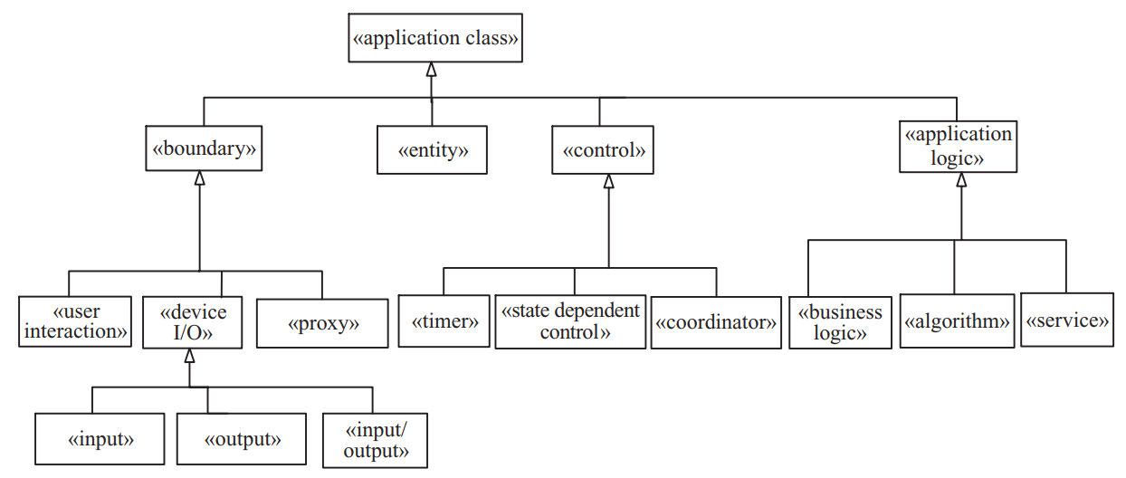
Overview Object & Class Structuring Categories 1/3

Slide 5
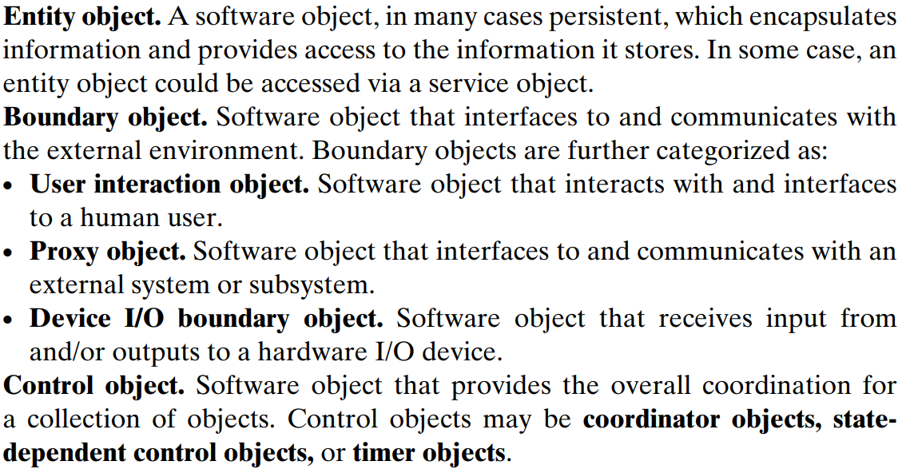
Overview Object & Class Structuring Categories 2/3

Slide 6
Overview Object & Class Structuring Categories 3/3
﻿Application logic object. Software object that contains the details of the application logic. Needed when it is desirable to hide the application logic separately from the data being manipulated because it is considered likely that the application logic could change independently of the data.
For information systems, application logic objects are usually business logic objects
For real-time, scientific, or engineering applications, they are usually algorithm objects.
Another category is service objects, which provide services for client objects, typically in service-oriented architectures and applications

Slide 7
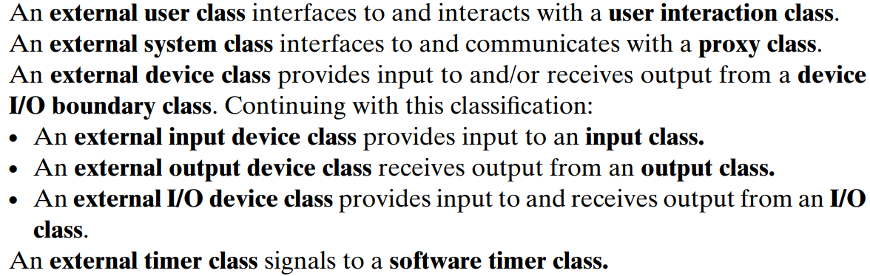
External Classes & Software Boundary Classes
﻿User Interaction Objects
A user interaction object communicates directly with the human user, receiving input from the user and providing output to the user via standard I/O devices such as the keyboard, visual display, and mouse.
Depending on the user interface technology, the user interface could be very simple (such as a command line interface) or it could be more complex (such as a graphical user interface [GUI] object).

Slide 8
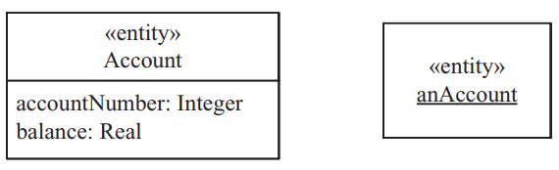
Entity Classes & Objects
﻿An entity object is a software object that stores information.
Entity objects are instances of entity classes, whose attributes and relationships with other entity classes are determined during static modeling
﻿Entity objects store data and provide limited access to that data via the operations they provide.

Slide 9
Control Classes & Objects
﻿A control object provides the overall coordination of the objects that realize a use case.
Simple use cases do not need control objects. However, in a more complex use case, a control object is usually needed.
A control object is analogous to the conductor of an orchestra, who orchestrates (controls) the behavior of the other objects that participate in the use case, notifying each object when and what it should perform.

Slide 10
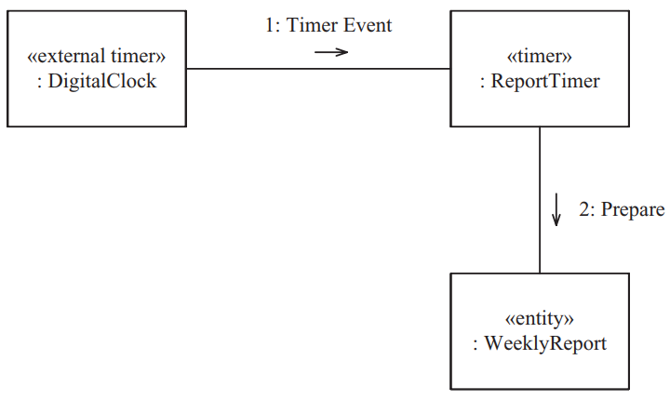
Control Classes & Objects Categories of Control Objects
Depending on the characteristics of the use case, the control object may be state-dependent or timer objects
﻿A state-dependent control object is a control object whose behavior varies in each of its states
﻿A timer object is a control object that is activated by an external timer – for example, a real-time clock or operating system clock. The timer object either performs some action itself or activates another object to perform the desired action

Slide 11
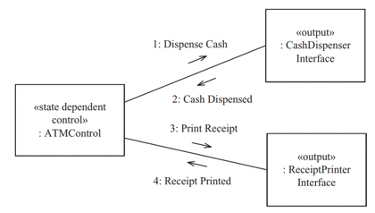
Control Classes & Objects State-dependent Control Object
A state-dependent control object receives incoming events that cause state transitions and generates output events that control other objects.
The output event generated by a state-dependent control object depends not only on the input received by the object but also on the current state of the object.
Example: state-dependent control object ATM Control is defined by means of the ATM Control state-chart. In the example, ATM Control is shown controlling two other output boundary objects, Receipt Printer Interface and Cash Dispenser Interface.

Slide 12
Application Logic Classes & Objects Business Logic Objects 1/2
﻿Defines the business-specific application logic for processing a client request. The goal is to
Encapsulate (hide) business rules that could change independently of each other into separate business logic objects.
Separate the business rules from the entity data that they operate on, because the business rules can change independently of the entity data.

Slide 13
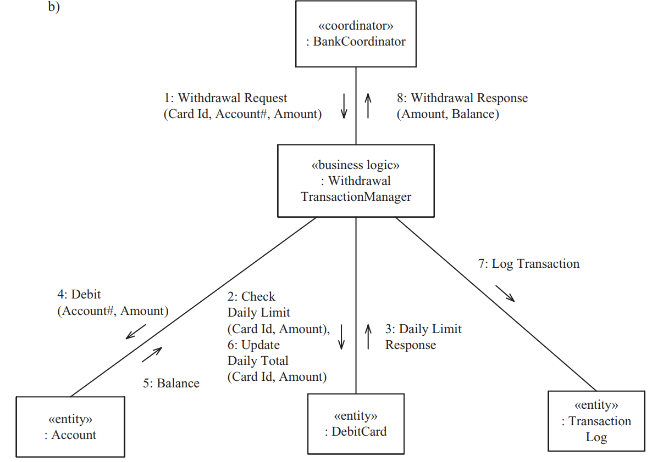
Application Logic Classes & Objects Business Logic Objects 2/2

Slide 14
Application Logic Classes & Objects ﻿Algorithm Objects 1/2
﻿﻿An algorithm object encapsulates an algorithm used in the problem domain. This kind of object is more prevalent in real-time, scientific, and engineering domains.
Algorithm objects are used when there is a substantial algorithm used in the problem domain that can change independently of the other objects
﻿Simple algorithms ﻿are usually operations of an entity object that operate on the data encapsulated in the entity

Slide 15
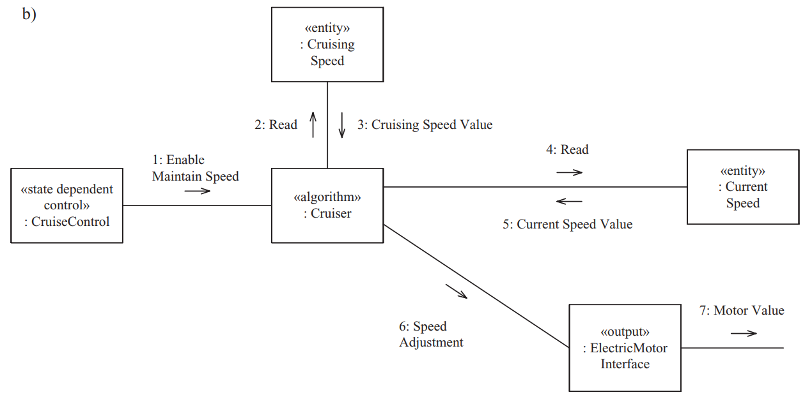
Application Logic Classes & Objects Algorithm Objects 2/2

Slide 16
Application Logic Classes & Objects ﻿Service Objects 1/2
﻿﻿ ﻿A service object is an object that provides a service for other objects. They are usually provided in service-oriented architectures and applications.
﻿Client objects can request a service from the service object, which the service object will respond to. A service object never initiates a request; however, in response to a service request it might seek the assistance of other service objects.
Service objects play an important role in service-oriented architectures, although ﻿they are used in other architectures as well, such as client/server architectures and component-based software architectures.
A service object might encapsulate the data it needs to service client requests or access another entity object(s) that encapsulate the data

Slide 17
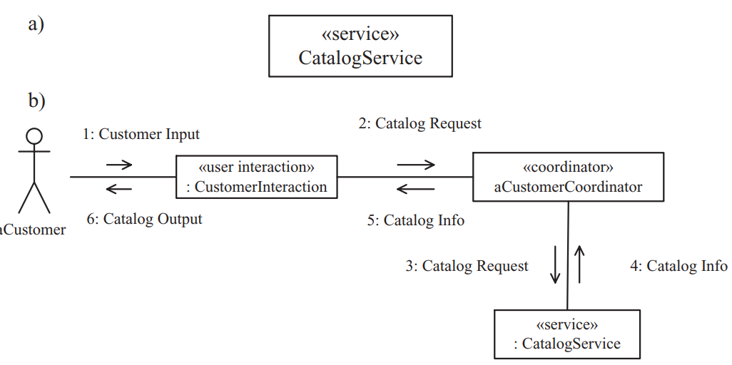
Application Logic Classes & Objects Service Objects 2/2

Slide 18


